Slide 1

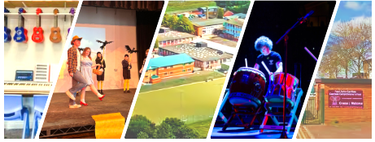
Information for Year 6
Learners, Parents and Carers
#MaximisingPotential

Slide 2

Information for Year 6
Learners, Parents and Carers
This presentation will give you an idea about life at Caerleon Comprehensive School.
It won’t cover every detail but it’s the start of what will be an amazing journey for you all!

Slide 3
Events
Y6 Moving Up Day.
TBC
Y6 Disco.
TBC

Slide 4
Moving Up Day
On Friday 4th July.
Your child needs to arrive in school by 9:20am. Your child may use the canteen if they arrive earlier but cannot purchase anything . They need to wear their current school uniform.
9:30-10:00am | Welcome assembly in Main Hall.
10:00-11:00am | Form Tutor Session
11:00-11:20am | Break
11:20-12:20pm | Lesson
12:20-1:00pm | Lesson
1:00-2:00pm | Lunch
2:00-2:30pm | Form Tutor Session
2:30pm | End of Day

Slide 5
Getting to School
Students should be in school by 8.30am.
If you are giving your child a lift then be aware that cars aren’t allowed through the main double gates.
If your child is walking make sure that they leave plenty of time so they’re not rushing. The pavement on Cold Bath Road is narrow so please be mindful of the traffic. If they’re cycling we have a nice big cycle storage area towards the back of the school - make sure that theybring a bike lock and wear a helmet!

Slide 6
Late on the Gate
Staff will be on the Main Gate to welcome your child to school each morning.
If they arrive after 8:45am they will be given a Behaviour Point.
It's really important that they get into a good morning routine so that they arrive at school each day with time to spare.

Slide 7
What do students need to bring?
A suitable school bag – pencil case, pens, pencils, maths equipment (a list is in the Transition Booklet on the school website). They will be given books in school.
Bring a reusable water bottle to keep hydrated.
If they aren’t buying lunch from the canteen, they will need to bring a packed lunch - keep it healthy!
No PE kit is required on the first day.

Slide 8
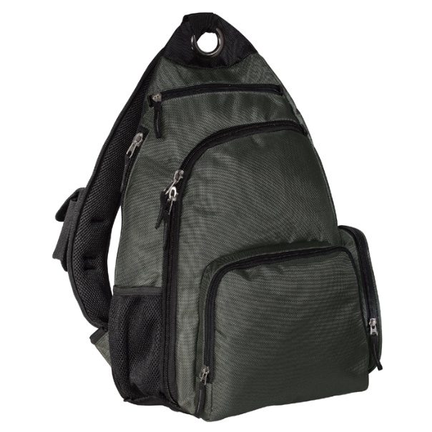
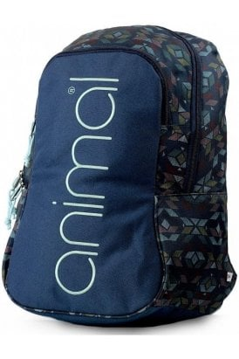
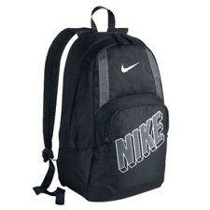
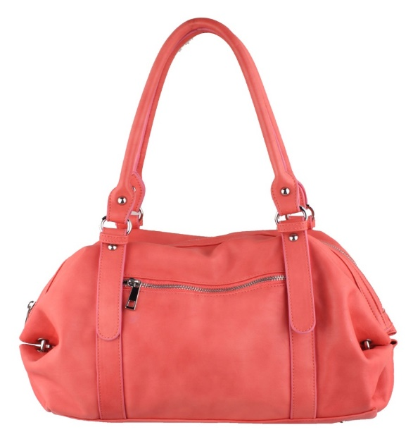
What bag is suitable?
Make sure that they bring a strong bag that they can carry easily. It should be big enough to fit in their books in for each day. We recommend a backpack/rucksack similar to those shown below (no handbags please!). They can have any colour.

Slide 9
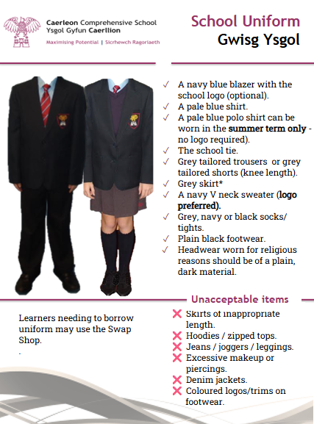
School Uniform - please see the policy on our website

Slide 11
School Skirts
A logoed skirt purchased from one of our suppliers (any style) or a pleated grey skirt (logo optional).
(This can be purchased from our suppliers with a logo, but also from other shops without a logo such as a local supermarket).

Slide 12
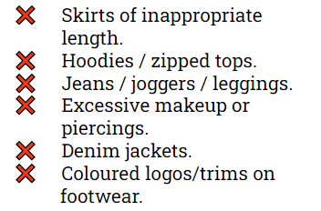
Unacceptable items

Slide 13
Uniform Swap Shop
What happens if a student wears the incorrect uniform to school?
Learner is sent to the Swap Shop which provides uniform.
Behaviour Point added.
The learner must return the item at 3:05pm.
If the item is not returned further behaviour points are added.
If still not returned a charge will be applied to the School Gateway App.
If there is an issue with buying / borrowing / returning school uniform, please contact the Swap Shop and we will be able to help.

Slide 14
Our Uniform - P.E. Kit
A logoed black and white school PE shirt or a plain black or white t-shirt. Black running or cycling shorts style (logo optional) or black leggings (logo optional). A logoed school quarter zip long sleeve top or plain black quarter zip long sleeve top. White sport socks (for inside). Trainers (for inside). A maroon rugby shirt for those who wish to play rugby. Maroon hockey/rugby socks. Studded boots (for outside games lessons on grass). Learners may wear black skins under clothes in cold weather.

Slide 15
Our Uniform
You will have already been emailed information about our approved uniform suppliers:
Macey Sports | 01633 259334 | https://www.maceysports.co.uk/
Beam Sports & Schoolwear | 01633 222261 | https://www.beamnewport.co.uk/
Pretty Miss | 01633 484408 | https://www.kidsschoolkits.co.uk/

Slide 16
First Day
Wednesday 2nd September will be their first day in school. Only Year 7 and 12 will be in school on that day.
All Year 7 learners will meet outside Main Reception at
8.30am. School starts at 8.45am promptly.
Year 7 will go into the Main Hall where they will be met by Mrs Purcell (Headteacher), Mrs Morgan (Head of Year) and your Form Tutor.
School photos will be on TBC

Slide 17
Form Groups
There are 8 Form Groups in
Year 7. There is no
difference between the
Form Groups and it doesn’t
matter which one you have
been placed in. They will all
have a mix of abilities,
personalities and talents!
Will they be with their friends in their Form Group?
They will not be with all of their friends, but they will be with at least one person from their Primary School.
TBC
TBC
TBC
TBC
TBC
TBC
TBC
TBC

Slide 18
The School Day
Reg. | 8.45 – 9.00am
Period 1 | 9.00- 10.00am
Period 2 | 10.00 – 11.00am
Break | 11.00 – 11.20am
Period 3 | 11.20 – 12.20pm
Period 4 | 12.20 – 1.20pm
Lunch | 1.20 – 2.05pm
Period 5 | 2.05-3.05pm

Slide 19
Registration
Registration is from 8.45-9.00am every day with their
Form Tutor in their Form Room. It is essential that they
are not late as this is when the morning register will be
taken, activities undertaken and important messages
read out.
There will be an assembly for the whole year group once
a week instead of registration. Year 7 assembly is on a
Friday.

Slide 20
Break and Lunch
At break and lunchtime they may use the canteen and outdoor areas.
The car parks are out of bounds.
Students are not allowed to stay in classrooms or corridors at break or lunch.

Slide 21
Break and Lunch
Students should bring a snack for breaktime and ensure that they remain hydrated during the day – there are several water fountains available.
Energy drinks are not allowed in school.
Students are NOT allowed off the school site at any point during the school day.

Slide 22
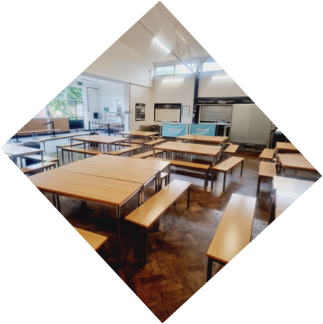

The Canteen

Slide 23
The Canteen
The canteen operates a “cashless” system - students cannot buy items using cash.
The school uses the School Gateway App and money can be put onto their account using this.
Details will be sent before term starts.
Students that are eligible to free school meals will automatically have their accounts credited. New applications need to be made as this does not carry over from Primary school.

Slide 24
Learner Wellbeing
The wellbeing of our learners is a priority at Caerleon and we have a dedicated Student Support Corridor where key pastoral staff can be found by learners at any point during the school day.
It’s really important that students let a member of staff know if there’s a problem. If we don’t know about it, we can’t help!

Slide 25


Learner Wellbeing

Slide 26
Learner Wellbeing
School Nurse
KS3 Learning Coaches
Family Engagement Officer / CLA Co-Ordinator
Pupil Assistance Leads (PALS)
Learner
School Based Counsellors / Youth Worker
Attendance Officer
Education Welfare Officer
STEP Centre
Learning Support Base

Slide 27


Our RADY Pledge
Free school meals applications/school essentials grant need to be reapplied for this year.
If you think that your child would be entitled to free school meals then make the application, as a school we will get extra funding that we can use to support your child.
#Standinthegap
#Sefyllynybwlch

Slide 28
Extra-curricular activities
Welsh – Lunchtime Club.
Maths - UK Maths Challenge Competition.
Art – Afterschool Club.
Drama Club.
Fairtrade Group (KS3).
Eco-Club.
Games Club – Dungeons and Dragons style.
PE - rugby, football, netball, cross-country, gymnastics, tennis, athletics, cricket, basketball, volleyball.
Music – choir, orchestra, musical theatre, school production, rock band.
French – lunch time club run by 6th Form Students.
Christian Club.

Slide 29
Your Timetable
Caerleon Comprehensive School uses a two-week
timetable cycle. This means that that they need to know
which week it is (Week 1 or Week 2) in order to prepare
correctly for the following day.
Students won’t have the same lessons at the same time on the same day (or even in the same room – maybe even with a different teacher!).

Slide 30
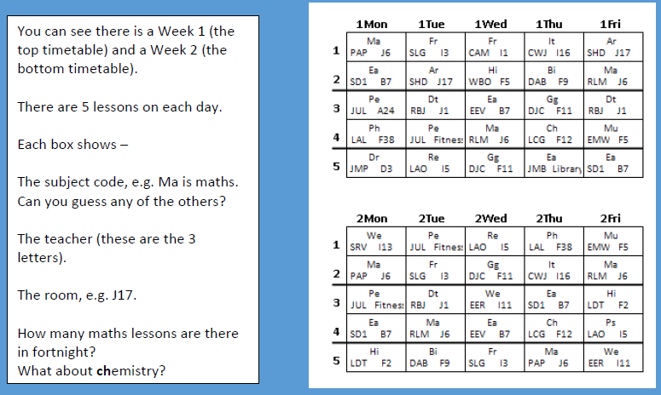
Timetable

Slide 31
Recognising Achievement
Good behaviour and a positive attitude toward school will be recognised and celebrated. There are several ways in which this is done, including -
Achievement Points from their subject teacher.
An email home from subject teachers.
Recognition within Form Group sessions by Form Tutors.
Headteacher’s Award.
An email/praise postcard from the Head of Year.
A “Celebration of Success” assembly each half term.
Attendance on trips and visits is linked to good behaviour in school.

Slide 32

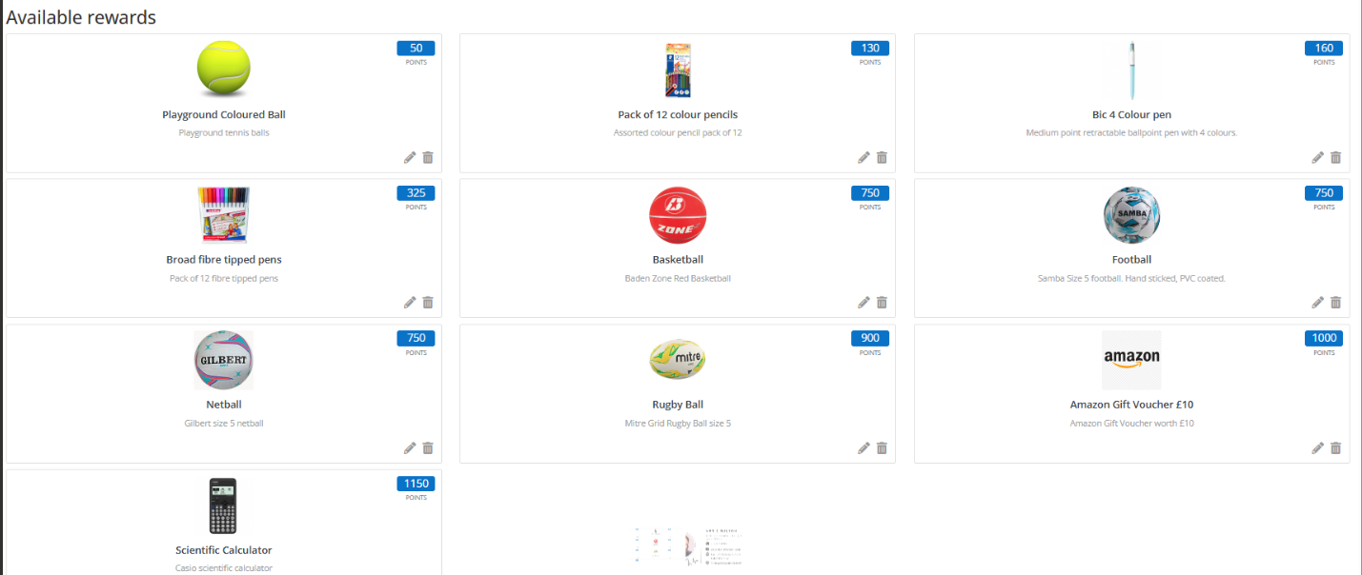
Class Charts Reward Store

Slide 33
Our Conduct Code
We expect all of our learners to behave appropriately and respectfully at all times. Whilst in lessons everyone follows a simple “Conduct Code” system. This will be explained to them in detail in September. The purpose of the system is to allow students to learn without distraction and therefore get the most from their lessons.
Unacceptable behaviour is recorded and “behaviour points” are given. Learners who get behaviour points are given sanctions and parents/carers are informed.

Slide 34
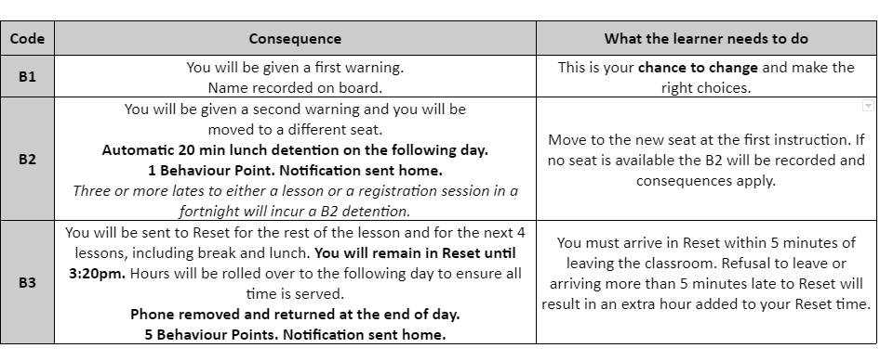
Our Conduct Code

Slide 35
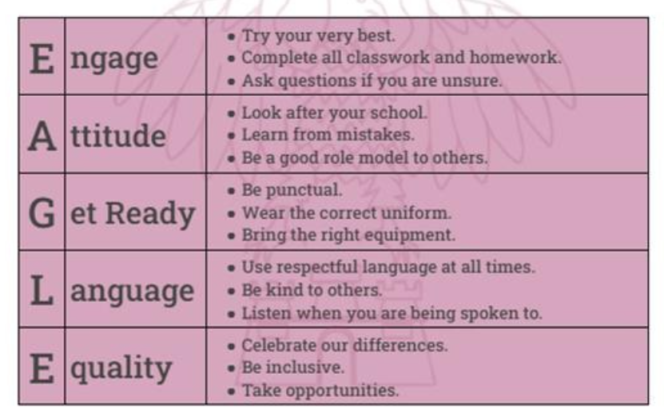
Maximise your Potential by following our
Eagle Expectations
Notes:
Assemblies this week on this.

Slide 36
Mobile Phones
Caerleon Comprehensive is a mobile-free school.
Phones / Airpods / tablets are not allowed “gate-to-gate”.
If a student brings a phone to school it must be turned off and left in their bag.
Devices will be confiscated if seen.
If this happens more than once parents/carers will be called to collect the device.
The school accepts NO responsibility for items that are
lost, damaged or stolen.

Slide 37
Social Media
The school has a Social Media policy and expects all learners to behave appropriately online both whilst in school and at home.
If there is evidence of inappropriate usage, e.g. comments, bullying, threats, photos then parents/carers will be informed and it is possible that there will be police involvement also.
Learners are expected to take responsibility for their actions online and appropriate sanctions will be carried out if unacceptable behaviour is displayed.

Slide 38
Assessment
Classwork and homework is continually assessed and by teachers throughout the year. They will get regular feedback on how to improve their work.
You will be emailed a termly “Progress Check”. This gives an outline of how well your child is doing in each subject, along with an indication of their “Attitude to Learning”.

Slide 39
Keeping in Touch
The Head of Year, Mrs Morgan, will be the main point of contact for your parents.
If you need to come to school to discuss something, then they should email Mrs Morgan to arrange an appointment.
The email addresses for each Head of Year can be found on the school’s website.

Slide 40

Keeping in Touch
If a parent / carer arrives without an appointment it is possible that the Head of Year will be unavailable. In these circumstances a message will be taken, and you will be contacted in due course.
Our Communication Code can be found on our website:

Slide 41

Keeping in Touch

Slide 42


Keeping in Touch
Our main enquiries email address is:
caerleon.comprehensive@newportschools.wales
We also use the following social media platforms to share information:
    https://www.instagram.com/caerleoncomprehensiveschool
https://bsky.app/profile/caerleoncomp.bsky.social

Slide 43

What next?
Have a look at the Transition Booklet and this powerpoint (It gives information from each department plus a list of items needed for September) on the Information section of our school website.
You may also be interested to look at the prospectus which has further information in it.

Slide 44
Form Groups
You are invited to
meet your child's Form
Tutor in their Form Room.
This is an informal
introduction; should you
wish to have a private
discussion please speak to
a member of staff at
the end of this meeting
and an appointment can be
made.
TBC
TBC
TBC
TBC
TBC
TBC
TBC
TBC

Slide 45
…and finally.
Thank you for your attendance this evening!

