Slide 1
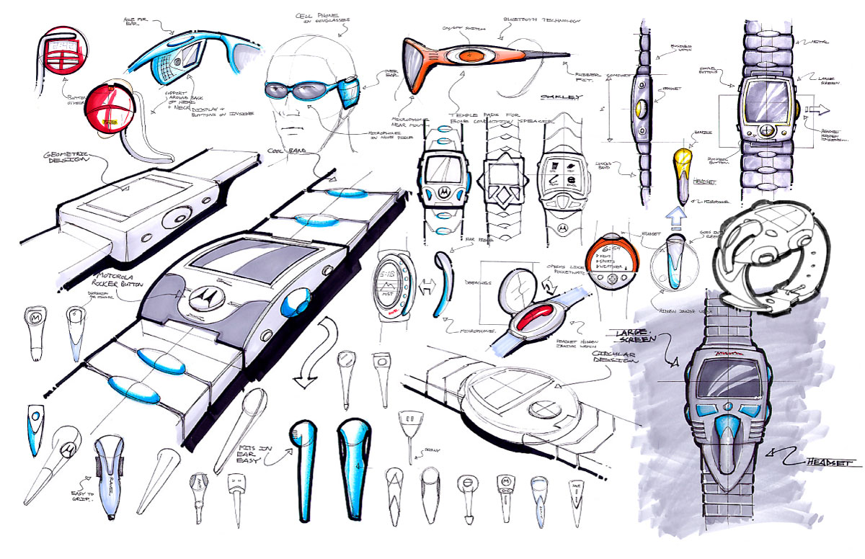
Why Study Design and Technology?

Slide 2
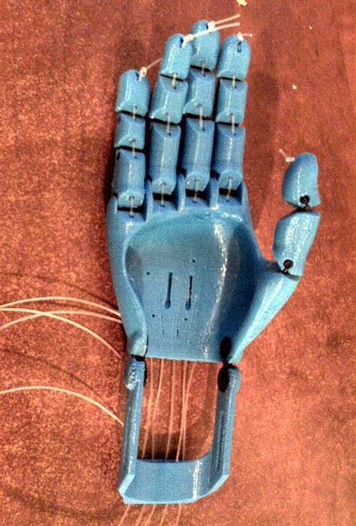
Why study Design Technology?
Design and Technology is a subject that transforms
Learn about designing solutions to improve people’s lives
Develop problem-solving and decision-making skills even further
Understand more about the impact of products upon the world.

Slide 3
Design and Technology is learning about …
how products and systems are designed and manufactured
how to be innovative
how to make creative use of a variety of resources, including digital technologies
how to problem solve
how to nurture independent research skills

Slide 4
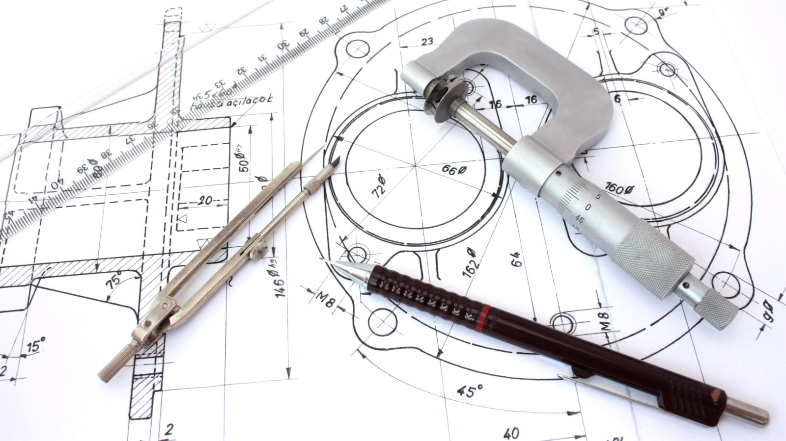
Design and Technology is learning about..
how to communicate complex ideas clearly and effectively.
the iterative design process and how constant development is required in the design process
critical evaluation and analysis skills

Slide 5
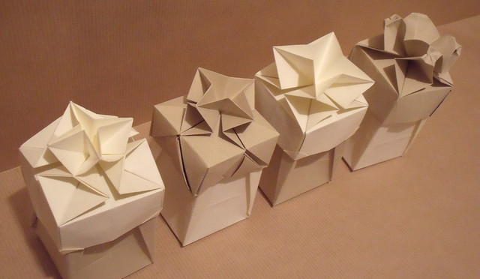
1. You need to be creative
Yes, you do, but it does not mean what you think it means.:
Firstly, no one is born creative — it is a learned skill which you will need to develop.
Secondly, imagination, creativity and innovation are often said to be the same thing, but this is not true: imagination is the ability to come up with many ideas; creativity is how original/’out of the box’ those ideas are; innovation is the creative ideas that are better than the existing solution to a problem.
All are important to be a problem-solver and the innovative solution will rarely strike without imagination or creativity.
Common Misconceptions about Design and Technology

Slide 6
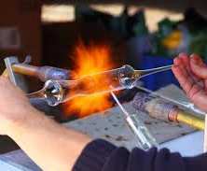
Common Misconceptions about Design and Technology
2. You need to be good with your hands.
Yes, it always helps, but it is not the be-all and end-all. It takes practice and, in particular, practice within the context of today’s design landscape —computer-controlled machinery, like CNC routers and 3d printers, are becoming more ubiquitous, and learning to use these tools is a sought after skill.

Slide 7
Common Misconceptions about Design and Technology
3. The product is all that matters
The product is not the only thing that matters: for a product to be innovative, you must take risks. This involves testing materials, methods and designs — this means there is always a chance of failure. Your project is a story of how your product is made and understanding of failure is more important than a product that is not creative or innovative.

Slide 8
Related Subjects at KS5
Maths
Physics
Art and Design
Computer science
Engineering
Business studies

Slide 9
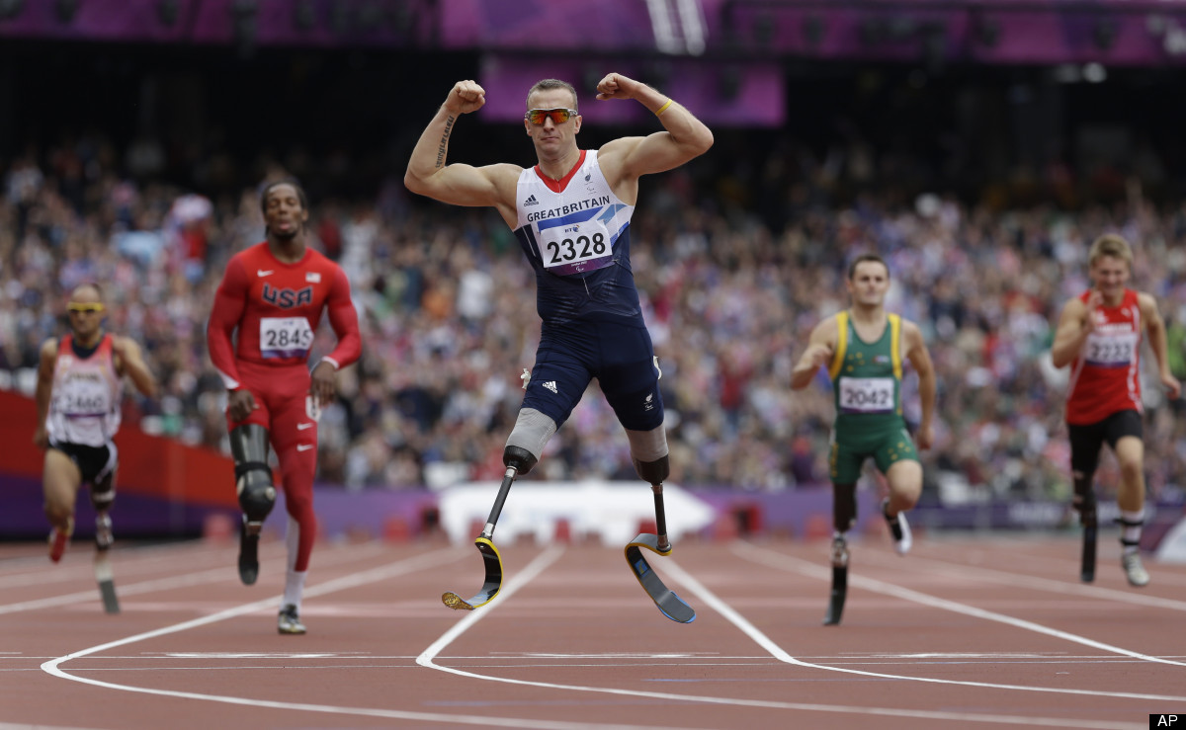
Why is Design and Technology important?
Design and Technology benefits society by…
Good design
Good design improves lives, making life easier for everyone and allowing people to live healthier lifestyles, keeping people safe.
Our surroundings have a massive effect on us. Our surroundings are largely man-made so good design plays a huge role. Studies show that well designed products and surroundings improve happiness and productivity.

Slide 10
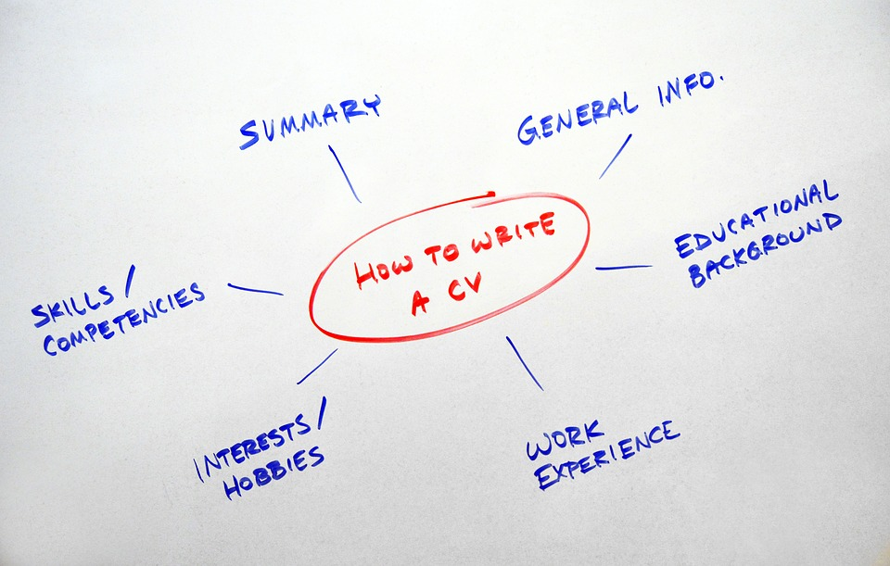
How Design and Technology makes you more employable
Task: how can Design and Technology improve your CV

Slide 11
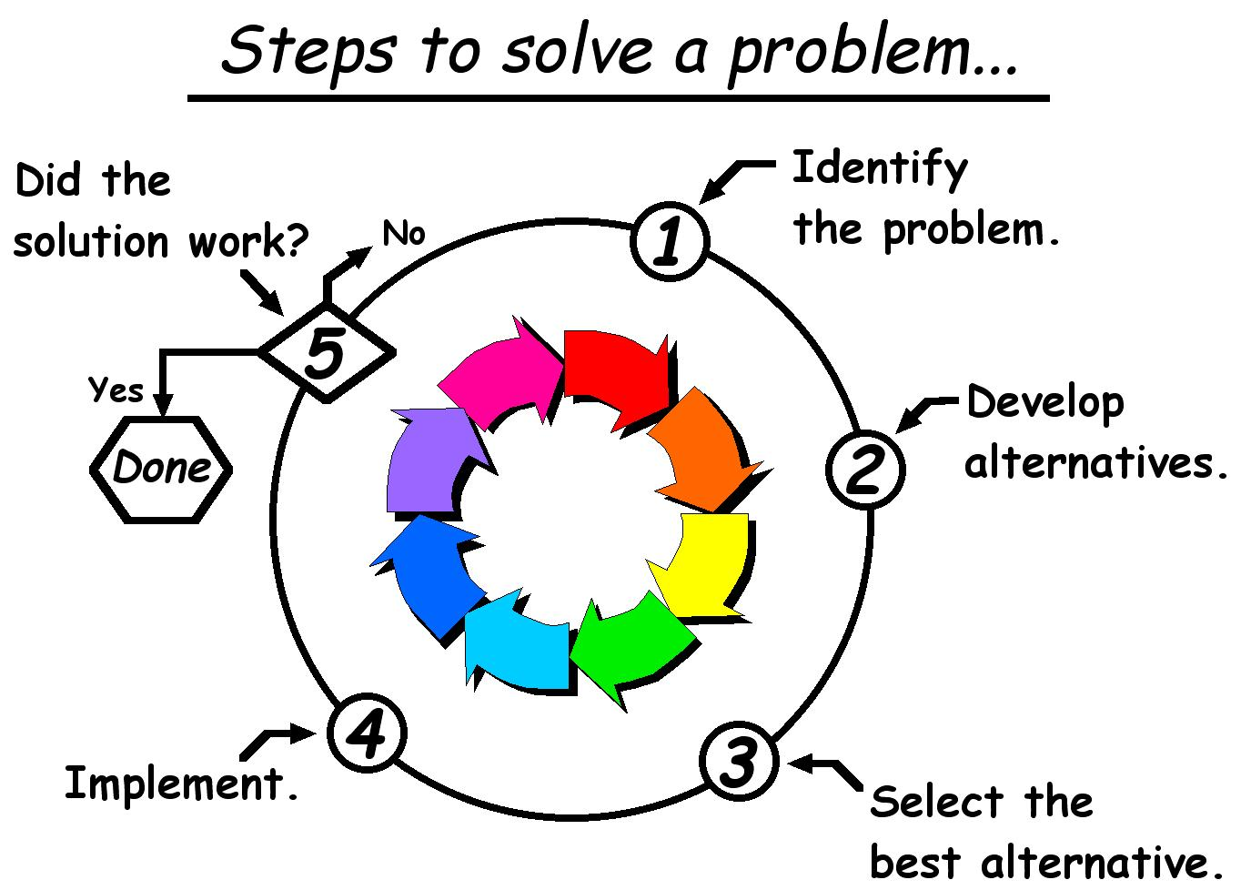
How Design and Technology makes you more employable
Design and Technology develops character-building traits, which will help you throughout life:
Logical thinking and problem-solving
Project management
Research and editorial skills
Presentation and other communication skills
Computer skills
Hands-on project management
Creativity
Software skills
An eye for detail.

Slide 12
How Design and Technology builds Character
Design and Technology projects teach you that failure is going to happen.
In the design world, it is important to fail as quickly as possible so that time and money is not spent on a poor idea that does not lead anywhere.
So, the quicker you fail, the more resources can be spent on a idea that will work.

Slide 13
How Design and Technology builds Character
Industrial design and most other design settings are collaborative, and being able to work in a group is imperative to success.

Slide 14
How Design and Technology builds Character
Learning to think critically forces you to effectively self-evaluate, and to be analytical about projects and processes that you are close to.

Slide 15
Skills Design and Technology develops…
Creativity and imagination
Dexterity
Decision making
2D and 3D communication
Critical analysis
Problem-solving skills

Slide 16
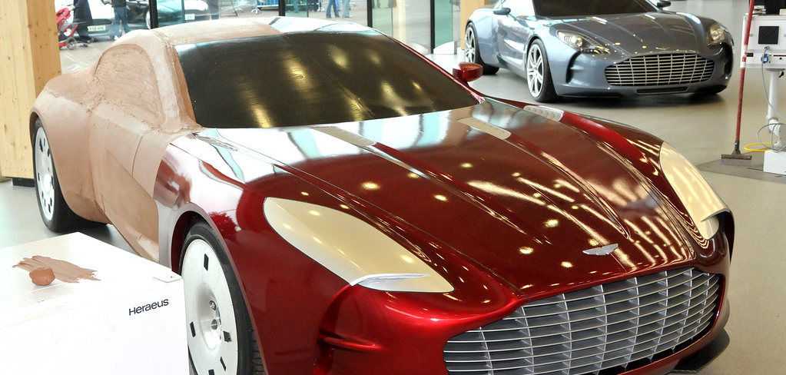
Why study Design and Technology?
The creative industries are worth 101.5 billion to the UK
Design and engineering has one of the highest employment rates after a degree
The average salary for a person in the creative industries is £39,500

Slide 17
What you can do with it?
Knowledge and skills learned in Design and Technology are high transferable.
For instance, according to one article, some current trainee surgeons may be academically gifted but they do not yet have the hand skills to do simple surgical procedures, like stitching a wound or using a scalpel precisely.
Roger Kneebone (imperial College London) calls for more creative subjects and says Design and Technology is useful for developing these skills.
https://www.bbc.co.uk/news/education-46019429

Slide 18
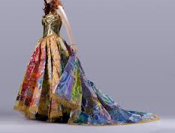
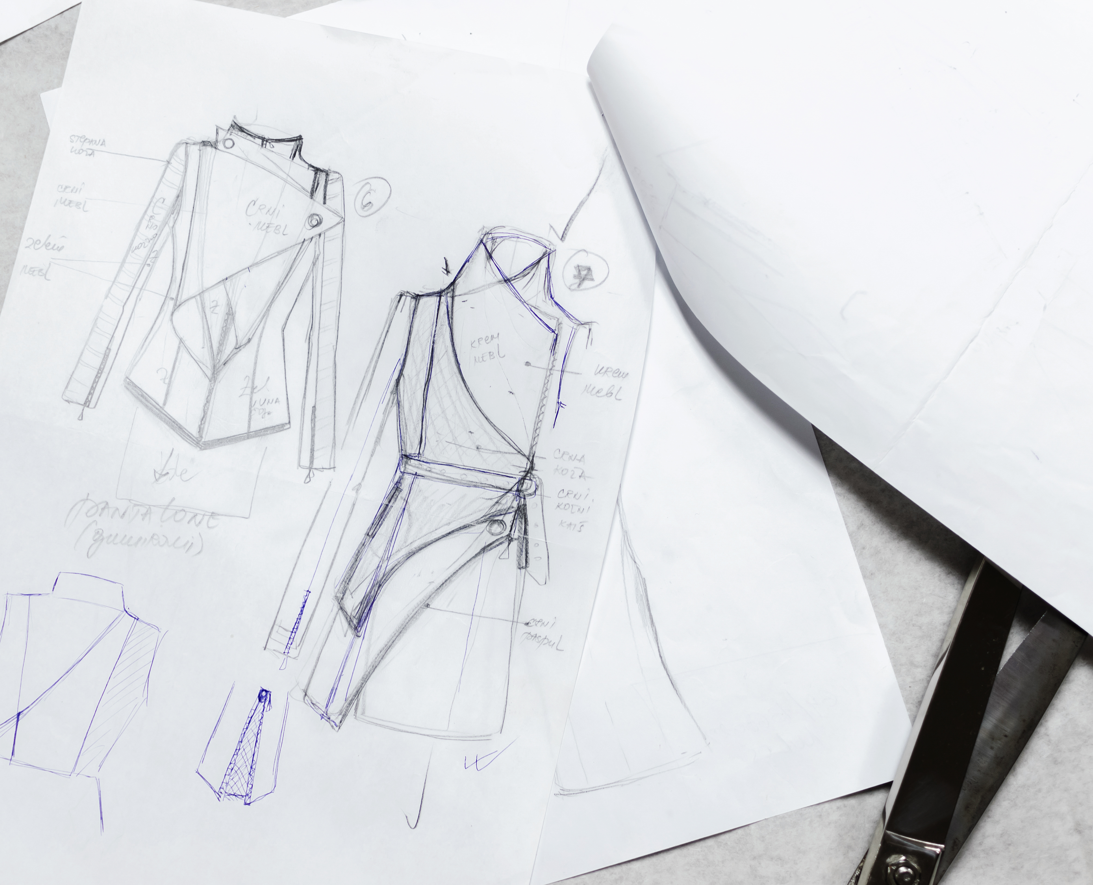
What you can do with it?
University and apprenticeships in:
Product Design
Architecture
Graphic Design
Manufacturing
Engineering
Jewellery
Fashion
Furniture Design
Civil Engineering

Slide 19
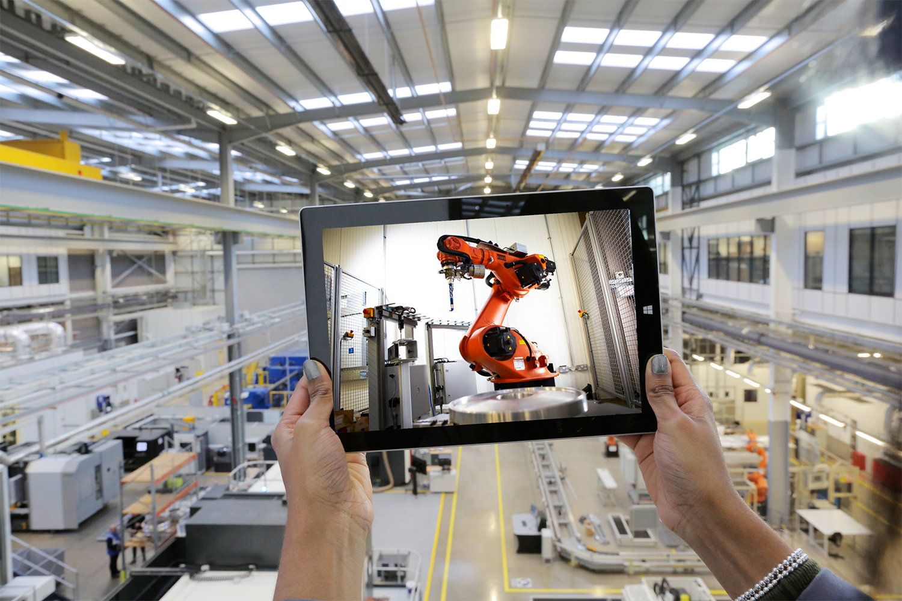
What can you do with it
Task: list as many jobs you can think of that will link to a Design Technology A level

Slide 20
Further Information
The website technologystudent.com offers a range of resources that will allow you to learn about Design and Technology.
To learn about the industry, icould.com has an excellent range of professionals discussing their field of expertise https://icould.com/explore/subject/design+technology
For careers in Design and Technology, www.notgoingtouni.co.uk shows a wide range of options.

Slide 21
© The PiXL Club Ltd. May 2019
This resource is strictly for the use of member schools for as long as they remain members of The PiXL Club. It may not be copied, sold, or transferred to a third party or used by the school after membership ceases. Until such time it may be freely used within the member school.
All opinions and contributions are those of the authors. The contents of this resource are not connected with, or endorsed by, any other company, organisation or institution. These papers were made by teachers in good faith based upon our understanding to date.
PiXL Club Ltd endeavour to trace and contact copyright owners. If there are any inadvertent omissions or errors in the acknowledgements or usage, this is unintended and PiXL will remedy these on written notification.

