Slide 1
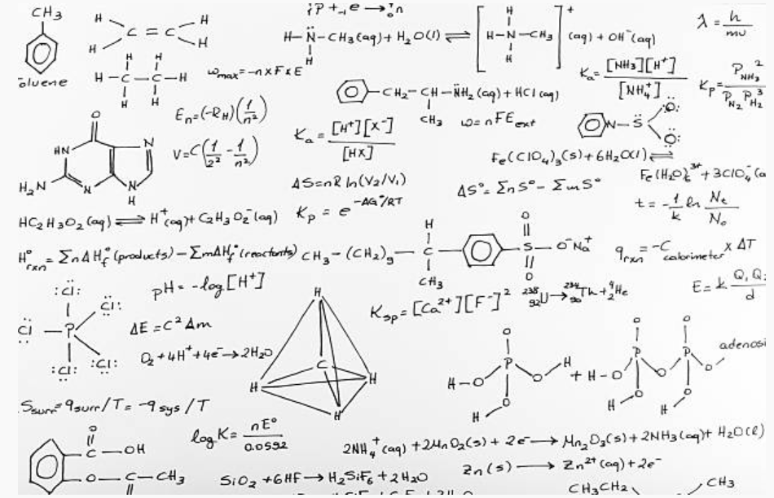
Why Study Maths?

Slide 2
Why is Maths Important?
Why study Maths A-Level?
Career opportunities
Employability skills
Preparation for higher education
Supporting other subjects
Transferable skills
Salary advantage
Notes:
Get pupils to think about what opportunities Maths A-Level presents.
Career opportunities - People who have studied mathematics are in the fortunate position of having an excellent choice of career.
Employability skills - employers highly value mathematics qualifications because students become better at thinking logically and analytically.
Preparation for higher education - Anyone applying to study a degree in a STEM subject should consider taking Further Mathematics to at least AS level as the additional content helps ensure a successful progression to university.
Supporting other subjects - mathematical skills you learn in A level Mathematics are of great benefit in other A level subjects such as physics, chemistry, biology, computing, geography, psychology, economics and business studies.
Transferable skills - The aspects of a student which are developed during a Mathematics course are easily extrapolated to other situations and areas. For example, rational and logical thought is something which is required in many areas, whether it is in a moral or career capacity.
Salary advantage - graduates earn on average a significant amount higher than the average starting salary.

Slide 3
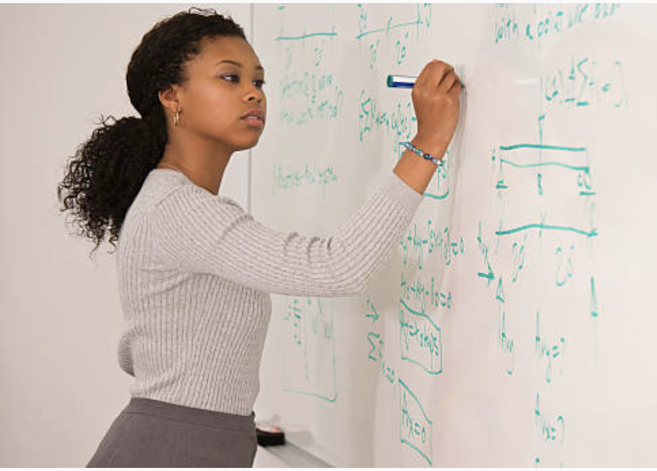
Common Misconceptions
I’m not good at Maths, and therefore I should focus on other subjects
It's all work and no play
Maths is going to be insanely difficult
I don’t have a mathematical mind
Maths has no use in real life
Mathematicians don’t know how to have fun
Boys are better at Maths than girls
Notes:
Organise yourself and you will have a good amount of free time throughout the week to pursue your own interests.
You will have to work and revise, so regardless of how easy or difficult you found your GCSEs, just go into your A Levels open-minded and ready to work.
Discuss Fixed and growth Mindset.
Fixed Mindset: reluctant to take on challenges; prefer to stay in your comfort zone; fearful of making mistakes; think it is important to 'look smart' in front of others; believe that talents and abilities are set in stone, you either have them or you don’t.
Growth Mindset: believe that talents can be developed; view mistakes as an opportunity to develop; are resilient; believe that effort creates success; think about how they learn.

Slide 4
Video – the mindset of high achievers
Video links to YouTube. We recommend that you embed.
Mindset of High Achievers (Video)
Notes:
https://www.youtube.com/watch?v=GVG4wgCqeEQ
Click the picture to play the video. We suggest you embed this to avoid ads and pop up. We are not able to do this due to our copyright restrictions.

Slide 5
TASK: What jobs could Maths support with?

Slide 6
What can I do with Maths?
Maths is needed in EVERY job at some level!

Slide 7
What can I do with Maths?
Accountant
Computer Programmer
Doctor
Engineer
Investment Manager
Lawyer

Slide 8
What can I do with Maths?
Games Developer
Teacher
Market Researcher
Banking
Government
Space/Aircraft Industry

Slide 9
How does Maths develop character and culture?
How has your character developed since year 11?
Notes:
Ask pupils to discuss how they think their character has developed throughout their school life. Have they become analytical in their thinking? Are they logical in their arguments? Etc.
Emphasise through gaining these skills they develop resilience and are able to think creatively and strategically in every situation.

Slide 10
How does Maths develop character and culture?
Critical thinking
Problem-solving
Analytical thinking
Quantitative reasoning
Ability to manipulate intricate ideas
Independence
Top 10 Movie Geniuses
Notes:
Ask pupils to discuss how they think their character has developed throughout their school life. Have they become analytical in their thinking? Are they logical in their arguments? Etc.
Emphasise through gaining these skills they develop resilience and are able to think creatively and strategically in every situation.

Slide 11
How does Maths develop character and culture?
Construct logical arguments and expose illogical arguments
Communication
Time management
Teamwork
Top 10 Movie Geniuses
Notes:
Ask pupils to discuss how they think their character has developed throughout their school life. Have they become analytical in their thinking? Are they logical in their arguments? etc
Emphasise through gaining these skills they develop resilience and are able to think creatively and strategically in every situation.

Slide 12
DISCUSS: What is going on with the colours?
Video
Notes:
Get students to discuss what is going on with the colours in the numbers 1 to 20.
Show video at 3:50 to 9:12

Slide 13
The demand for mathematics is increasing
“Adults with basic numeracy skills earn higher wages and are more likely to be in employment than those who fail to master these skills.”
“Individuals who achieve five or more good GCSEs (including English and mathematics) as their highest qualification have a lifetime productivity gain worth around £100,000 compared to those with below level 2 or no qualifications.”

Slide 14
The demand for mathematics is increasing
“Around half of individuals in jobs where mathematical sciences qualifications are essential were found to have salaries of £29,000 or more, compared with only 19 per cent of the UK workforce overall.”

Slide 15
The demand for mathematics is increasing
“It is generally accepted that attaining A level mathematics bestows a significant wage premium. The often-cited work by Dolton and Vignoles demonstrated that graduates from 1980 with a mathematics A level were earning 7-10 per cent higher wages in their early thirties compared to those who took A levels in other subjects.”

Slide 16
The demand for mathematics is increasing
“Between 2013 and 2020, employment in the UK is forecast to increase by 6 per cent, whilst demand for experts in software, data storage, retrieval and analysis is expected to rise by 160 per cent, reflecting the growing UK digital economy and the increasing amounts of data garnered from the internet.”

Slide 17
Further Information
The website icould.com offers a range of videos from professionals in the industry talking about their careers. Follow this link to see the range of careers available to you, and listen to people who are actually working within those:
https://icould.com/explore/subject/maths
Alongside this, careermap.co.uk provide further information regarding careers:
https://careermap.co.uk

Slide 18
Commissioned by The PiXL Club Ltd. May 2019
This resource is strictly for the use of member schools for as long as they remain members of The PiXL Club. It may not be copied, sold, or transferred to a third party or used by the school after membership ceases. Until such time it may be freely used within the member school.
All opinions and contributions are those of the authors. The contents of this resource are not connected with, or endorsed by, any other company, organisation or institution. These papers were made by teachers in good faith based upon our understanding to date.
PiXL Club Ltd endeavour to trace and contact copyright owners. If there are any inadvertent omissions or errors in the acknowledgements or usage, this is unintended and PiXL will remedy these on written notification.

